Slide 1
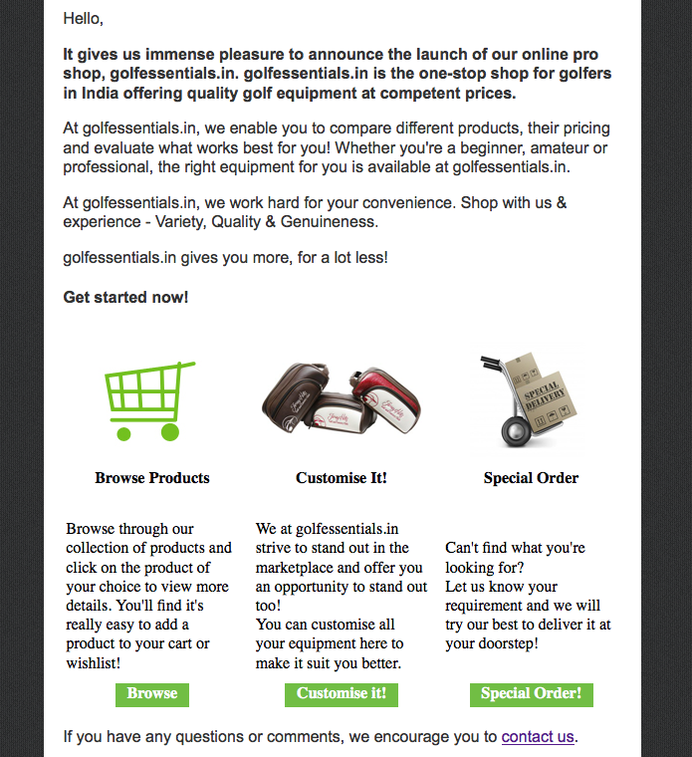
“our online pro shop, golfessentials.in” should appear in one line
Increase space
Will purchase this image post which Special Delivery needs to be replaced with Special Order
Decrease space
Replace text & align to the top:
Can’t find what you’re looking for?
Let us know your requirement by using our special order form or contacting us and we will try out best to deliver your products at your doorstep!
Decrease space
Remove exclamation mark
Increase space

